Slide 1
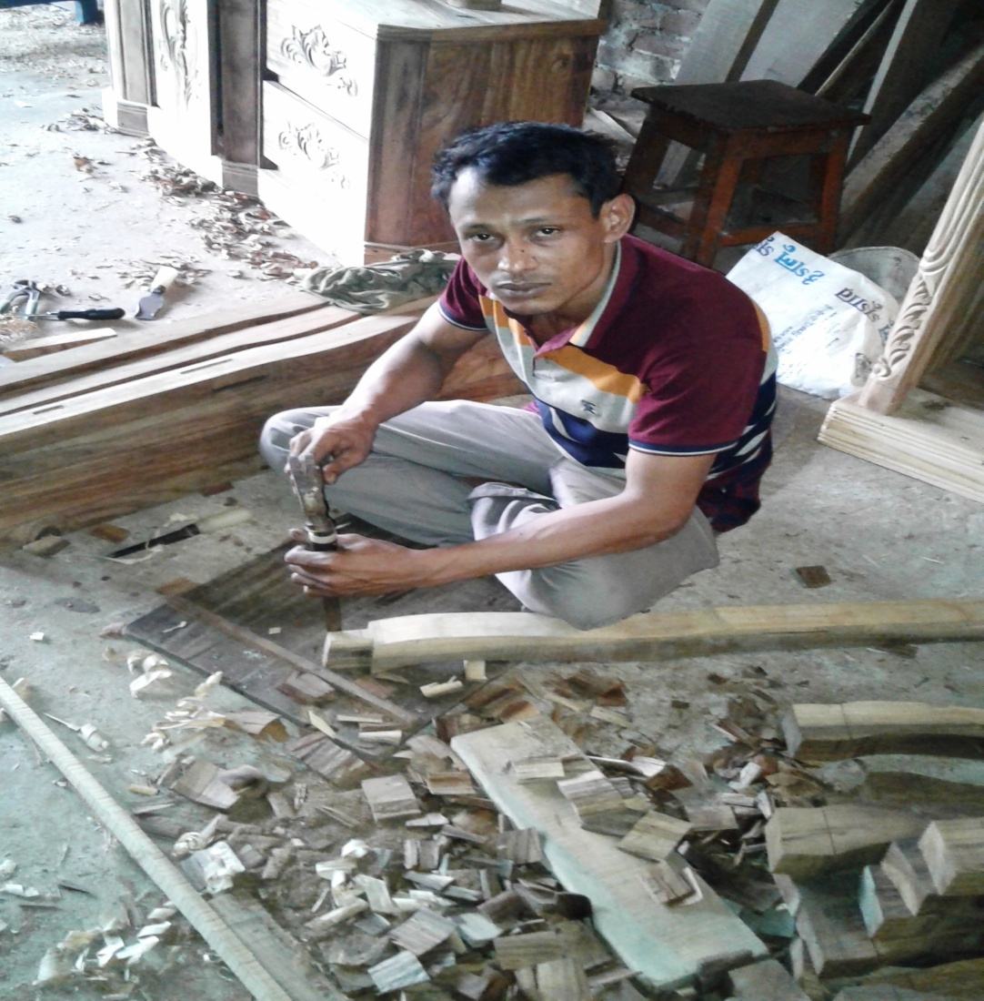
Sohag Furniture
Noakhali Unit
Region -2
Project by: Md. Sohag
Identified by: Md. Billal Hossain
Verified By : Md. Zahidul Kabir
GRAMEEN TRUST

Slide 2
Brief Bio of the PROPOSED Nobin Udyokta
Name | : | Md. Sohag
Permanent Address | : | Bangla Bazar, Begomganj, Noakhali-3822
Age | : | 19-Jun-1985 (32Years)
Marital status | : | Married
Children | : | 3 Children
No. of siblings: | : | 03 Brothers, 02 Sisters
Parent’s and GB related Info (i) Who is GB member (ii) Mother’s name (iii) Father’s name (iv) GB member’s info Further Information: (v) Who pays GB loan installment (vi) Mobile lady (vii) Grameen Education Loan Any other loan like GCCN, GKF | : : : : : : : : | Mother Father Kamola Begum Amir Hossain Branch: Jirtoli Begomgonj, Centre 35/m Group no : 4, Loanee no.: 0, Member since: 2002 to 2009. First loan: 5,000/=, Existing loan: 30,000/-, Outstanding: Nil. N/A N/A N/A N/A N/A
Education | : | Class Eight

Slide 3
Brief Bio of the PROPOSED Nobin Udyokta (cont…)
Present Occupation | : | Wooden Furniture Business. Collect raw materials from Chowmohani Bazar. Local Consumer are the target customer group.
Initial Investment | : | 60,000/-
Trade License No |  | 90/2016-2017
Business Experience And Training Info | : : | 12 Years Received training from Chowmohani Bazar for 02years.
Other Own/Family Sources of Income | : | N/A
Other Own/Family Sources of Liabilities | : | N/A
NU Contact Info |  | +8801795-930019 (This number will be registered in SBMS System for Daily SMS)
NU Project Source/Reference | : | Noakhali Unit.

Slide 4
brief history of GB loan utilization by Family
NU’s mother has been a member of Grameen Bank since 2002 to 2009 (7 years). At first she took a loan of Taka 5,000/- from Grameen Bank. His father used GB loan in his business and repaired their own houses from his income. NU also built their own house from the income of GB loan. They also bought some land. NU’s mother gradually improved their life standard by using GB loan.

Slide 5
Proposed Nobin Udyokta business INFO
Business Name | : | Sohag Furniture
Address/ Location | : | Bangla Bazar, Begumgonj, Noakhali-3822
Total Investment in BDT | : | 3,30,000/-
Financing | : | Self BDT 2,50,000 (from existing business) 76% Required Investment BDT 80,000/-(as equity) 24%
Present salary/drawings from business (estimates) | : | 6,000/-
Proposed Salary | : | 6,000/-
Proposed Business % of present gross profit margin (ii) Estimated % of proposed gross profit margin (iii) Agreed grace period | : : : | 20% 20% 02 Months

Slide 6
Present & Proposed Investment Breakdown
Particulars | Existing Business (BDT) | Proposed (BDT) | Total (BDT)
Investments in different categories: | (1) | (2) | (1+2)
Present Stock Items: Advance 1,00,000 Furniture 80,000 Different kinds of wood 40,000 Tools 20,000 Furniture 5,000 Fan 5,000 | 2,50,000 |  | 2,50,000
Proposed items: Different kinds of Woods :- 70,000 (Bot Korai, Sishu, Mahagoni, Sil Korai) |  | 80,000 | 80,000
Total Capital | 2,50,000 | 80,000 | 3,30,000

Slide 7
Present & Proposed Investment Breakdown
Present Stock Items
Product name | Unit (Quantity) | Amount
Advance |  | 1,00,000
Different kinds of Wood | 98 CFT | 40,000
Furniture |  | 80,000
Tools |  | 20,000
Fan |  | 5,000
Used Furniture |  | 5,000
Total Present Stock |  | 2,50,000
Proposed Items
Product Name | Unit | Amount
Bot Korai Wood | 50CFT*500 | 20,000
Sishu Wood | 25CFT*800 | 20,000
Mahogoni Wood | 25CFT*1,000 | 20,000
Sil korai Wood | 50CFT*600 | 20,000
Total Proposed Stock |  | 80,000

Slide 8
INFO ON EXISTING BUSINESS OPERATIONS
Particulars | Existing Business (BDT)
 | Daily | Monthly | Yearly
Sales (A) | 5,000 | 1,50,000 | 18,00,000
Less: Cost of sales (B) | 4,000 | 1,20,000 | 14,40,000
Gross Profit (C) [C=(A-B)] | 1,000 | 30,000 | 3,60,000
Less: Operating Costs
Electricity bill |  | 500 | 6,000
Generator bill |  | 150 | 1,800
Shop Rent |  | 8,000 | 96,000
Night Guard bill |  | 100 | 1,200
Mobile bill |  | 500 | 6,000
Present salary/Drawings- self |  | 6,000 | 72,000
Present salary/Drawings- staff |  | 9,000 | 1,08,000
Conveyance or Transport] 2 No. |  | 1,000 | 12,000
Others (fees, Entertainment, TL renew) |  | 500 | 6,000
Non Cash Item:
Depreciation Expenses(5,000*10% +5,000*20% |  | 125 | 1,500
Total Operating Cost (F) |  | 25,875 | 3,10,500
Net Profit (E-F): |  | 4,125 | 49,500

Slide 9
Financial Projection of NU Business plan
Particulars | Year 1 (BDT) |  |  | Year 2 (BDT) |  |  | Year 3 (BDT)
 | Daily | Monthly | Yearly | Daily | Monthly | Yearly | Daily | Monthly | Yearly
Sales (A) | 5,000 | 1,50,000 | 18,00,000 | 5,500 | 1,65,000 | 19,80,000 | 6,000 | 1,80,000 | 21,60,000
Less: Cost of Sale (B) | 4,000 | 1,20,000 | 14,40,000 | 4,400 | 1,32,000 | 15,84,000 | 4,800 | 1,44,000 | 17,28,000
Gross Profit (A-B)=(C) | 1,000 | 30,000 | 3,60,000 | 1,100 | 33,000 | 3,96,000 | 1,200 | 36,000 | 4,32,000
Less: Operating Costs
Electricity bill |  | 500 | 6,000 |  | 500 | 6,000 |  | 500 | 6,000
Generator bill |  | 150 | 1,800 |  | 150 | 1,800 |  | 150 | 1,800
Shop Rent |  | 8,000 | 96,000 |  | 8,000 | 96,000 |  | 8,000 | 96,000
Night Guard bill |  | 100 | 1,200 |  | 100 | 1,200 |  | 100 | 1,200
Mobile bill |  | 500 | 6,000 |  | 500 | 6,000 |  | 500 | 6,000
Present salary/Drawings- self |  | 6,000 | 72,000 |  | 6,000 | 72,000 |  | 6,000 | 72,000
Present salary/Drawings- staff |  | 9,000 | 1,08,000 |  | 9,000 | 1,08,000 |  | 9,000 | 1,08,000
Conveyance or Transport |  | 1,000 | 12,000 |  | 1,000 | 12,000 |  | 1,000 | 12,000
Others (fees, Entertainment, TL renew) |  | 500 | 6,000 |  | 500 | 6,000 |  | 500 | 6,000
Non Cash Item:
Depreciation Expenses |  | 125 | 1,500 |  | 125 | 1,500 |  | 125 | 1,500
Total Operating Cost |  | 25,875 | 3,10,500 |  | 25,875 | 3,10,500 |  | 25,875 | 3,10,500
Net Profit (C-D) = (E) |  | 4,125 | 49,500 |  | 7,125 | 85,500 |  | 10,125 | 1,21,500
GT payback | 32,000 |  |  | 32,000 |  |  | 32,000
Retained Income: | 17,500 |  |  | 53,500 |  |  | 89,500

Slide 10
Cash flow projection on business plan (Rec. & Pay.)
Sl # | Particulars | Year 1 (BDT) | Year 2 (BDT) | Year 3 (BDT)
1.0 | Cash Inflow
1.1 | Investment Infusion by Investor | 80,000
1.2 | Net Profit | 49,500 | 85,500 | 1,21,500
1.3 | Depreciation (Non cash item) | 1,500 | 1,500 | 1,500
1.4 | Opening Balance of Cash Surplus |  | 19,000 | 74,000
 | Total Cash Inflow | 1,31,000 | 1,06,000 | 1,97,000
2.0 | Cash Outflow
2.1 | Purchase of Product | 80,000
2.2 | Payment of GB Loan
2.3 | Investment Pay Back Including Ownership Tr. Fee | 32,000 | 32,000 | 32,000
 | Total Cash Outflow | 1,12,000 | 32,000 | 32,000
3.0 | Net Cash Surplus | 19,000 | 74,000 | 1,65,000

Slide 11
SWOT Analysis
STRENGTH Skilled & experienced Well known in locality. Quality services. | WEAKNESS Less Capital
OPPORTUNITIES Shop position is in the center point of business area. Beside main road. | THREATS Fire . Theft.

Slide 12
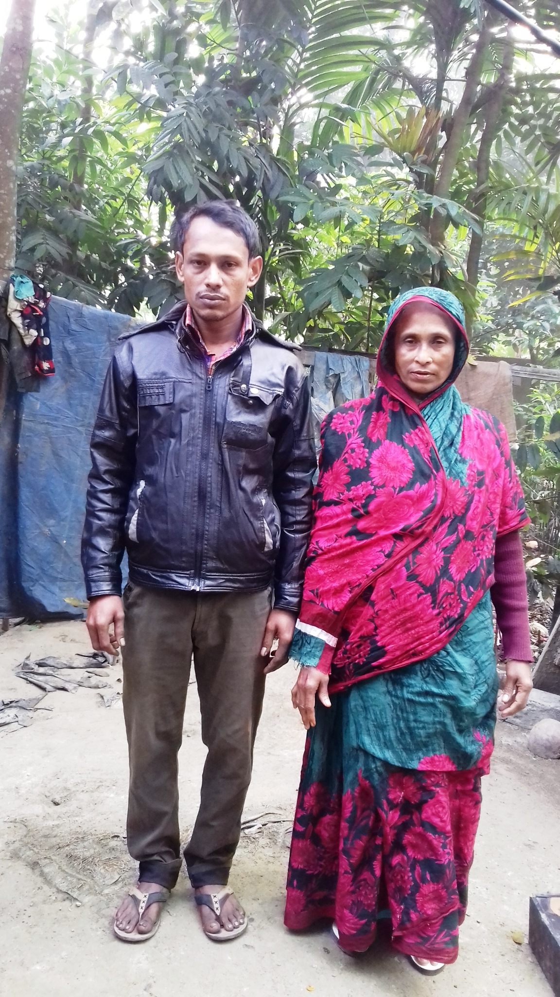

Slide 13
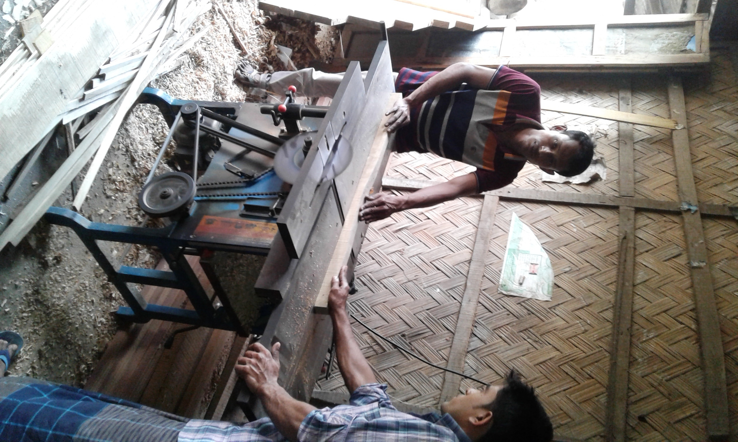

Slide 14
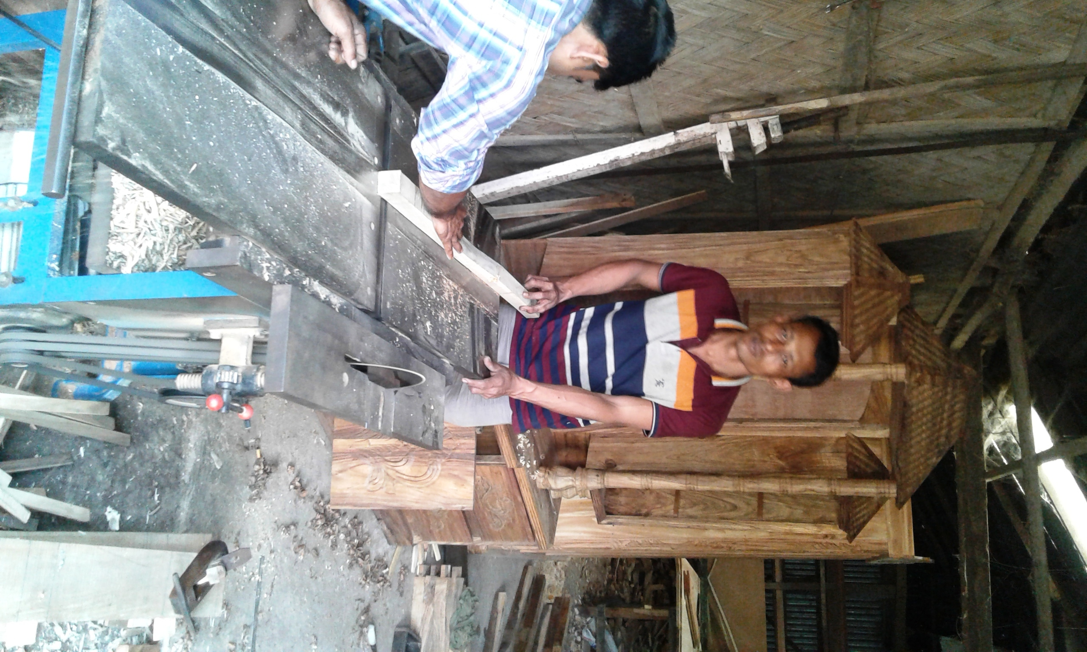

Slide 15
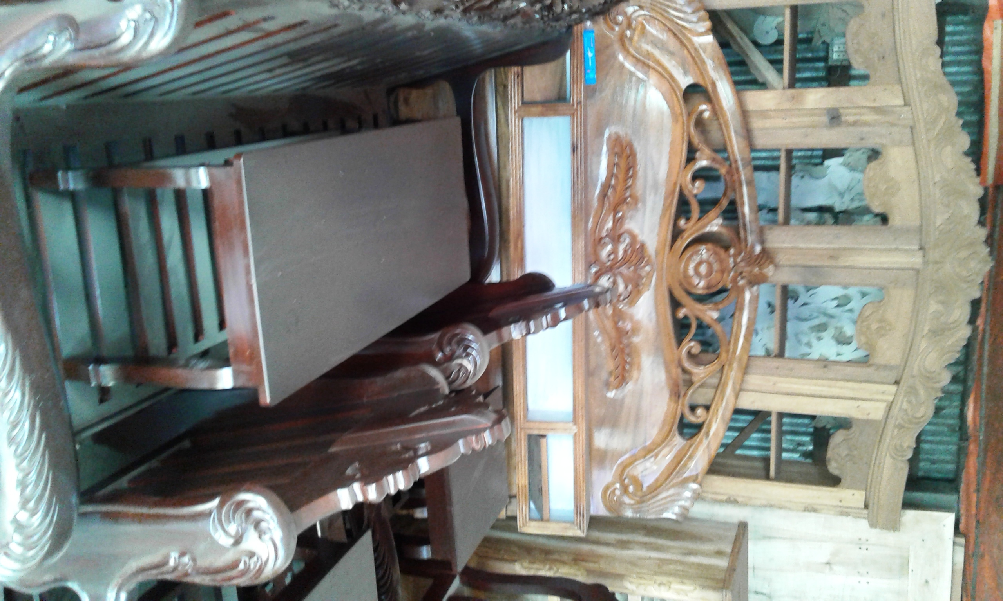

Slide 16
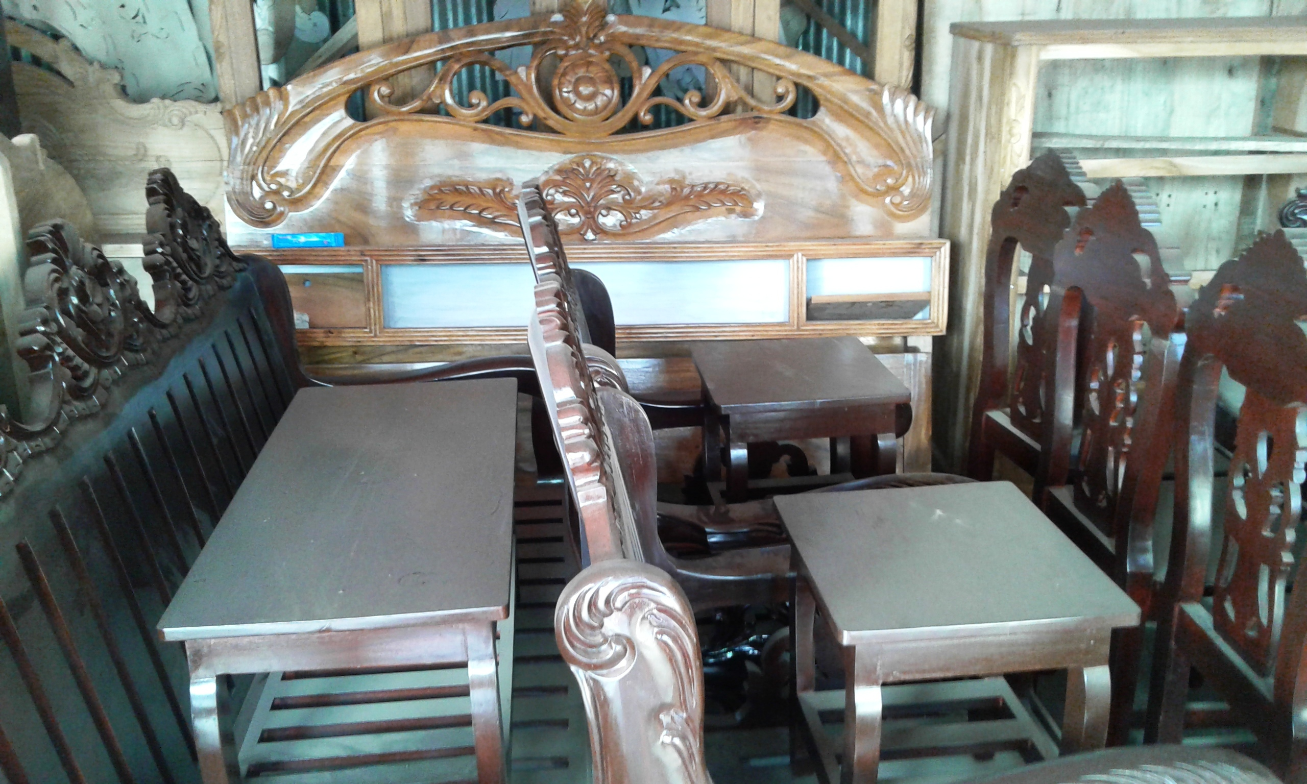

Slide 17
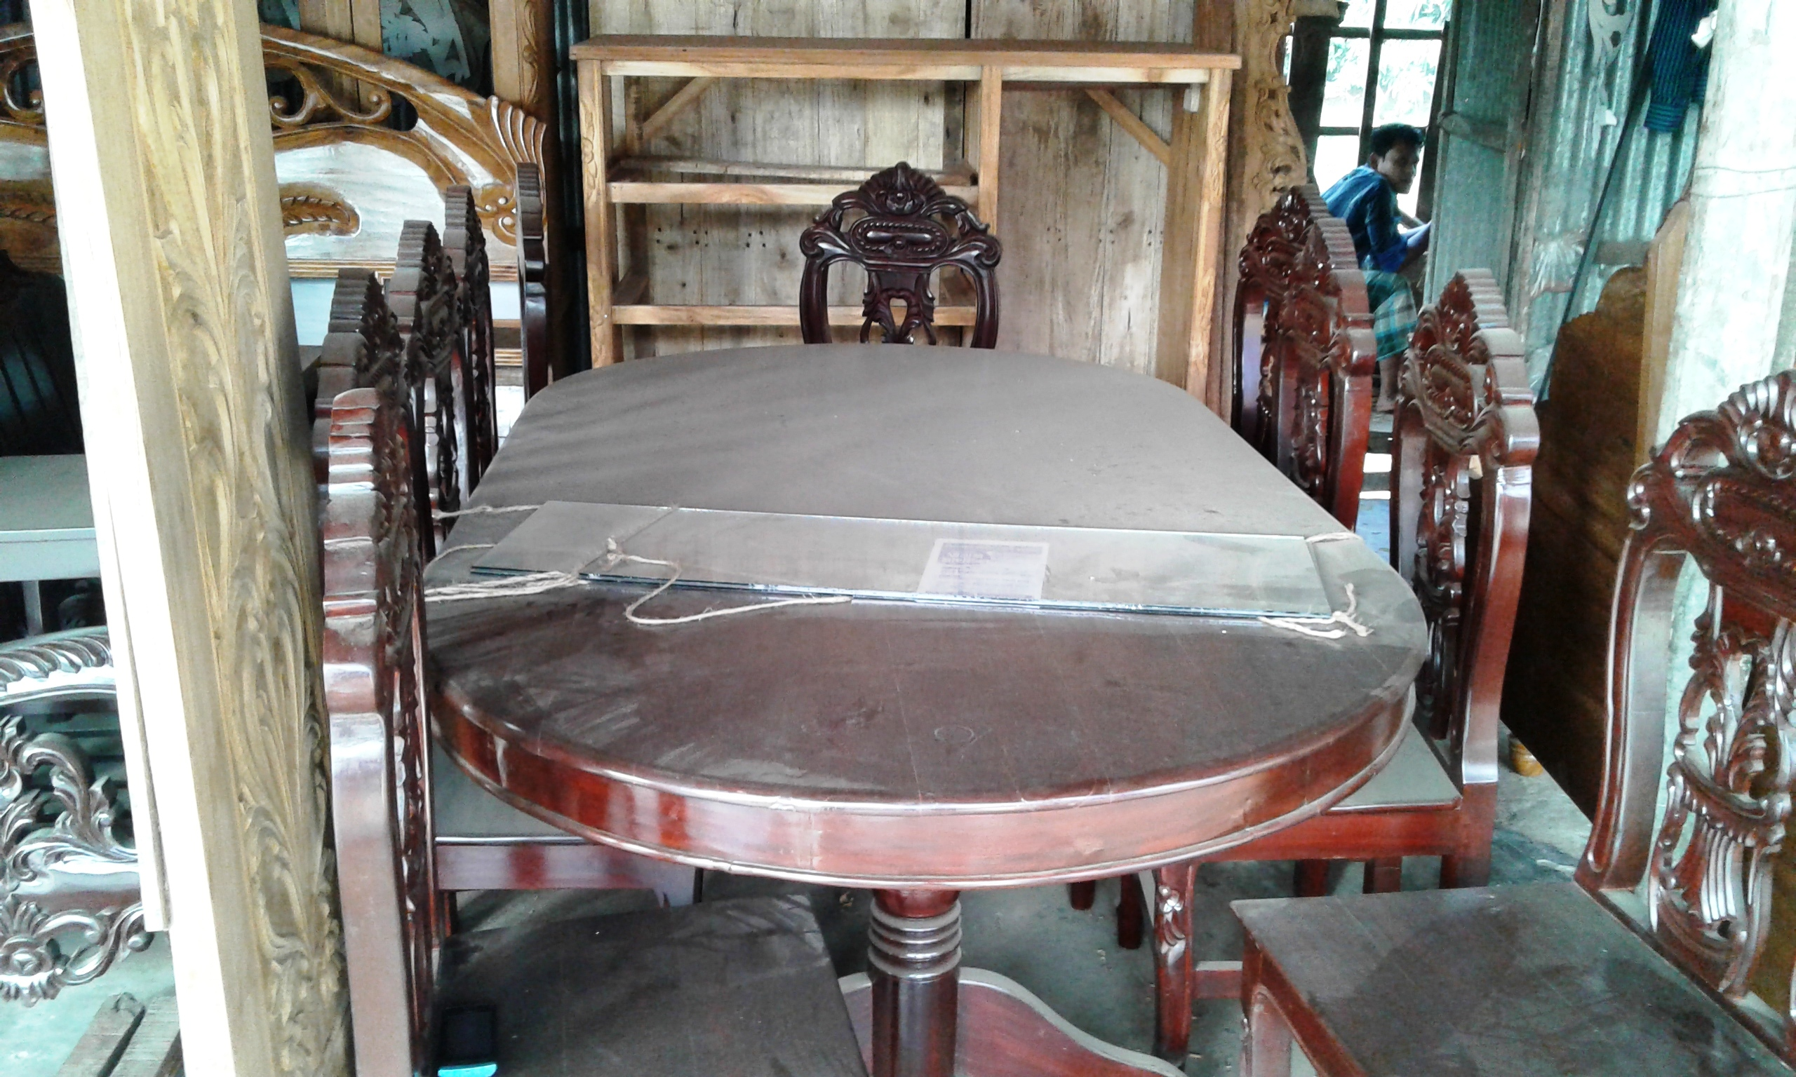

Slide 18
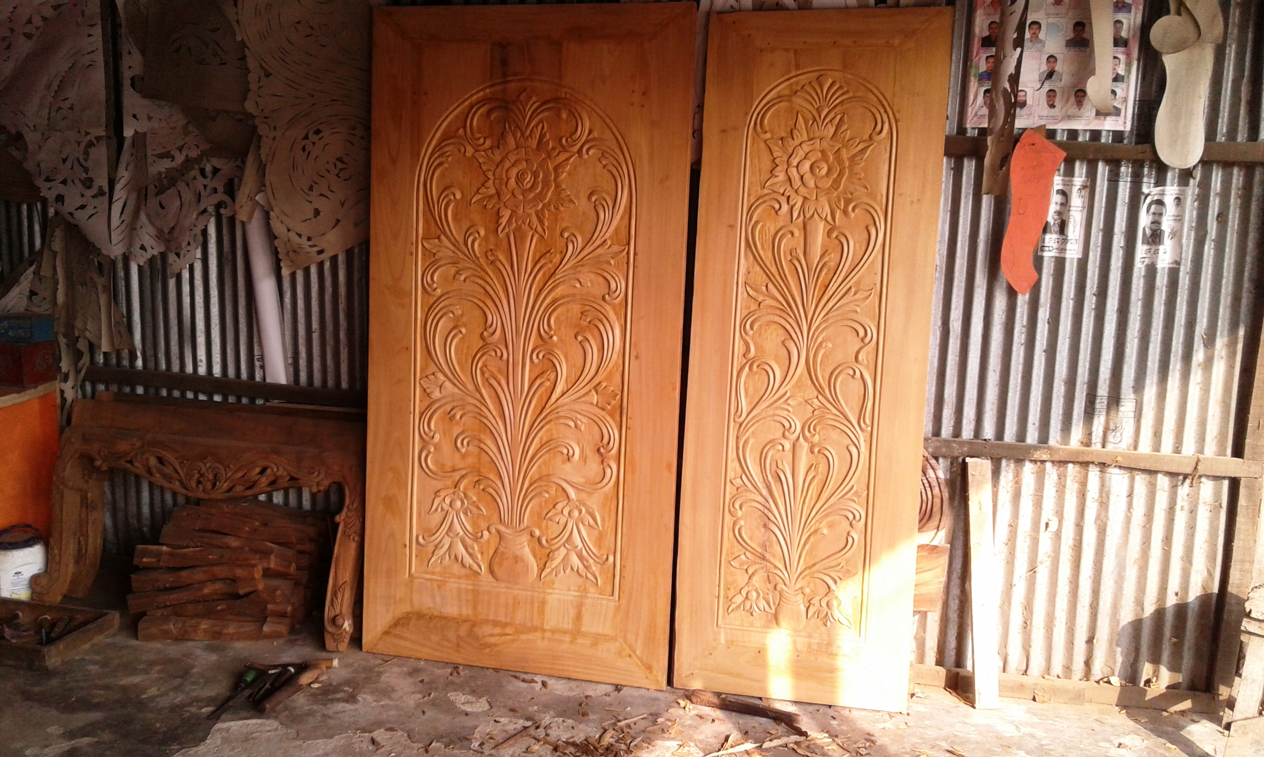

Slide 19
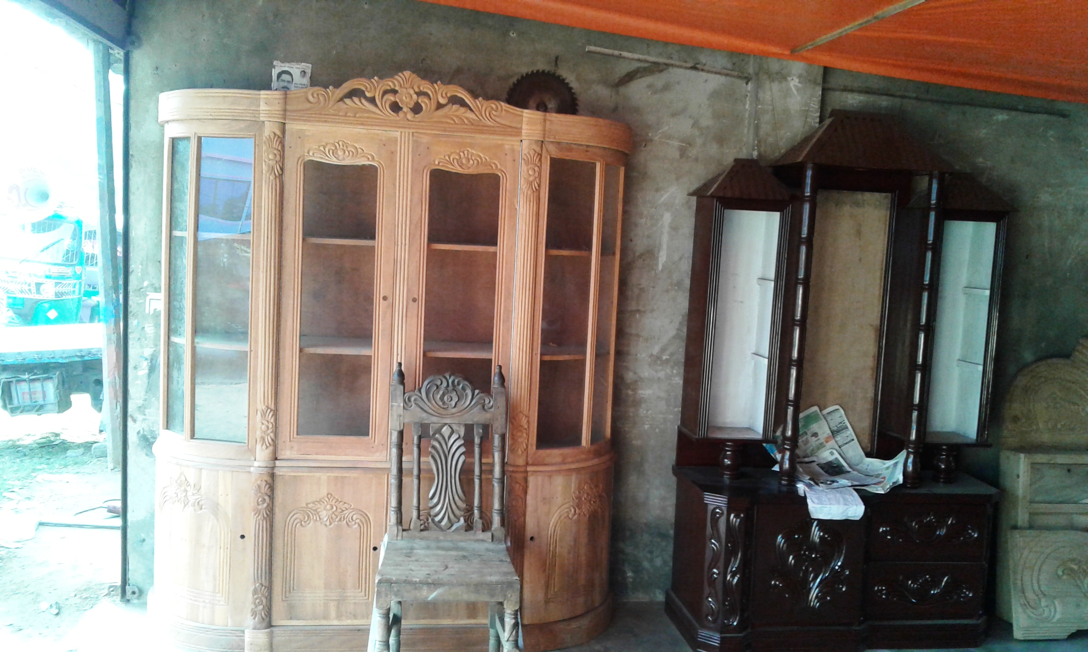

Slide 20
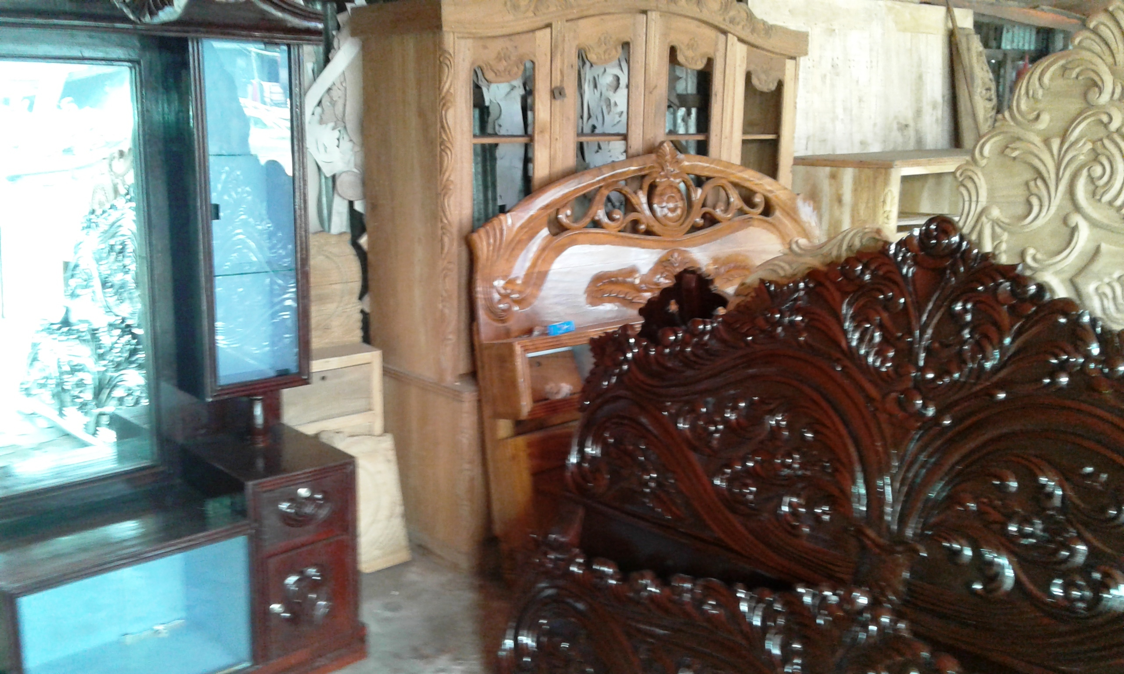

Slide 21
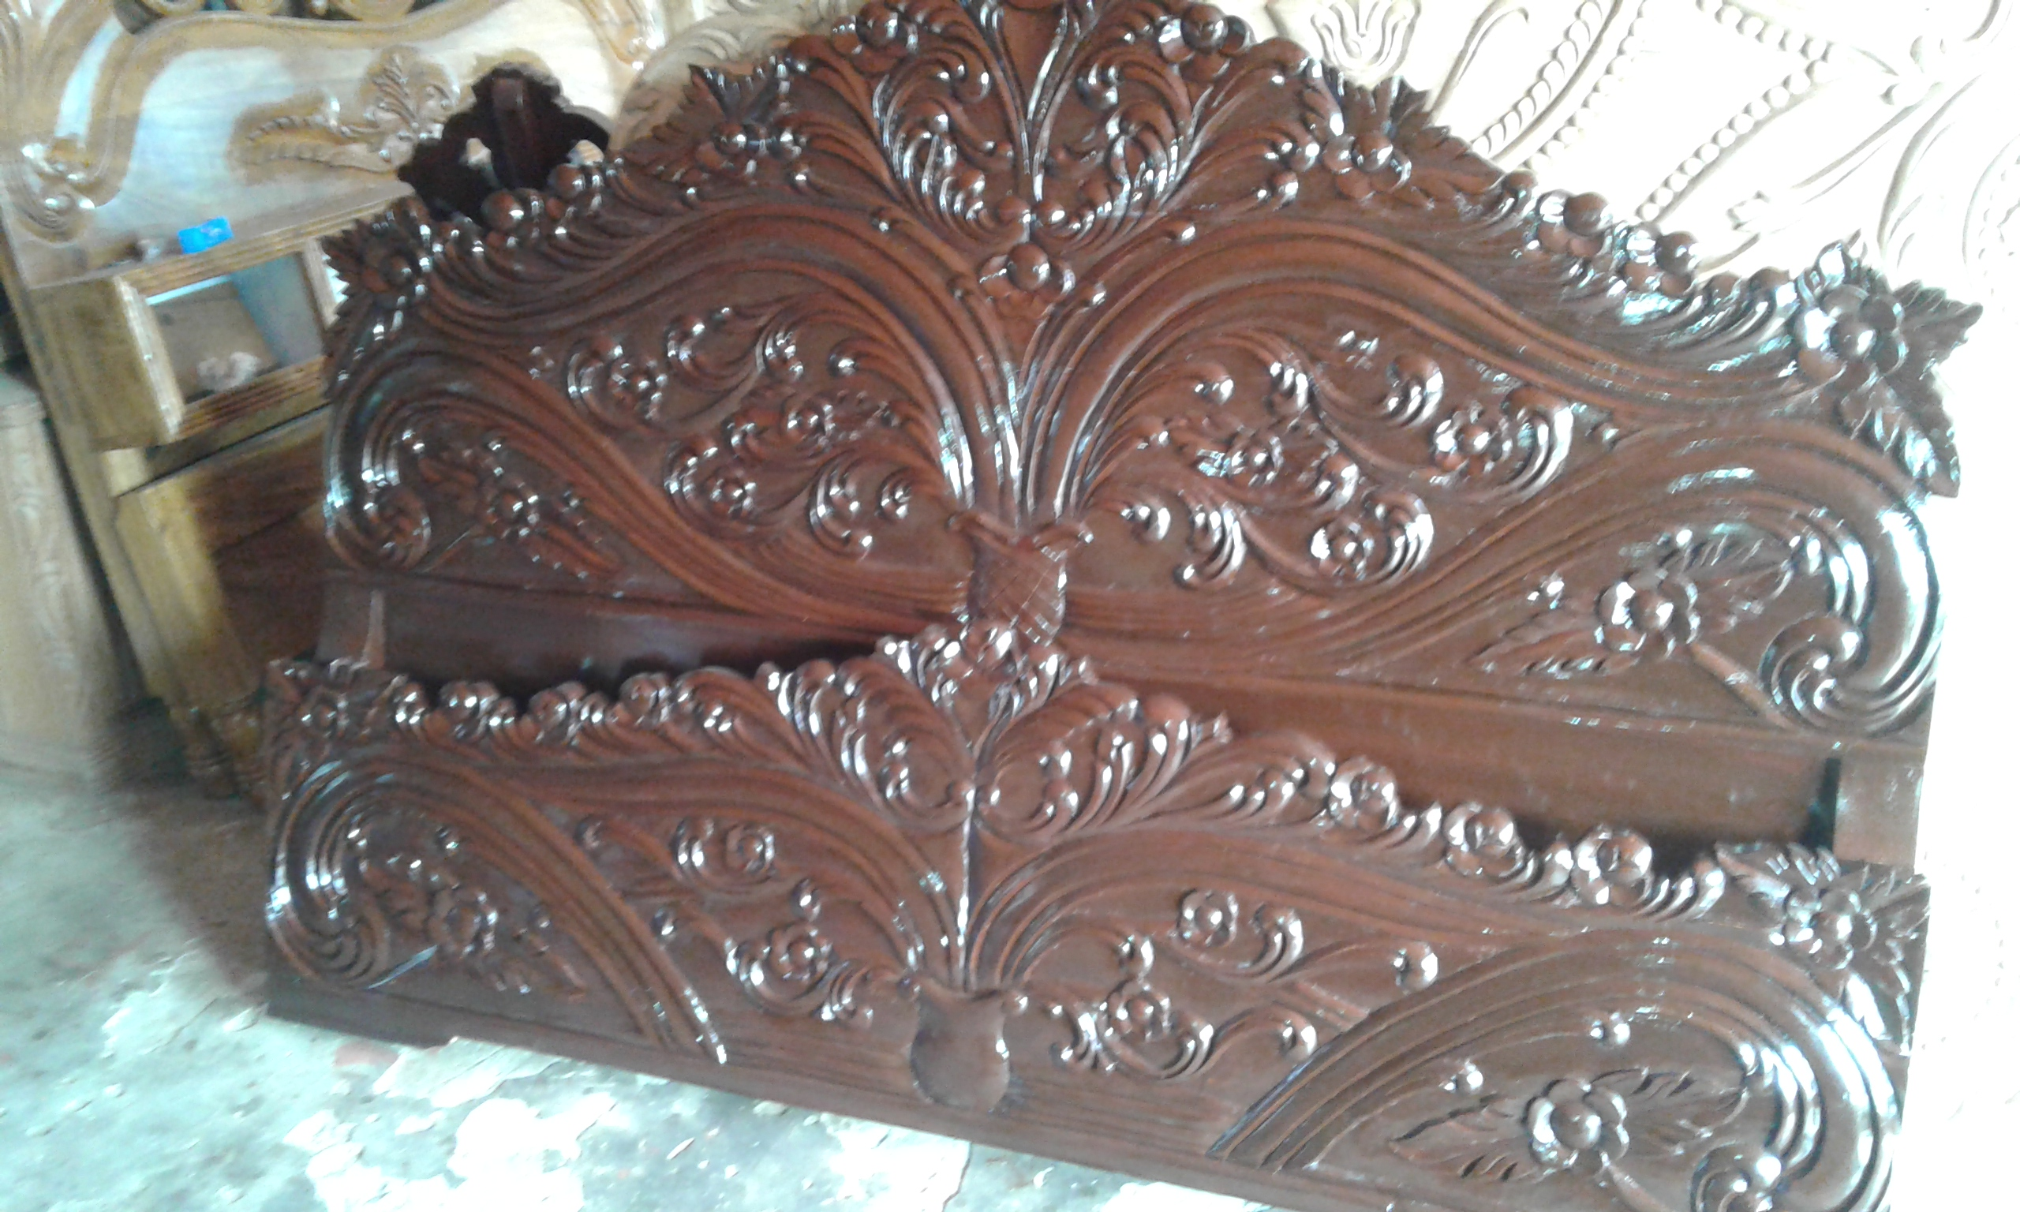

Slide 22
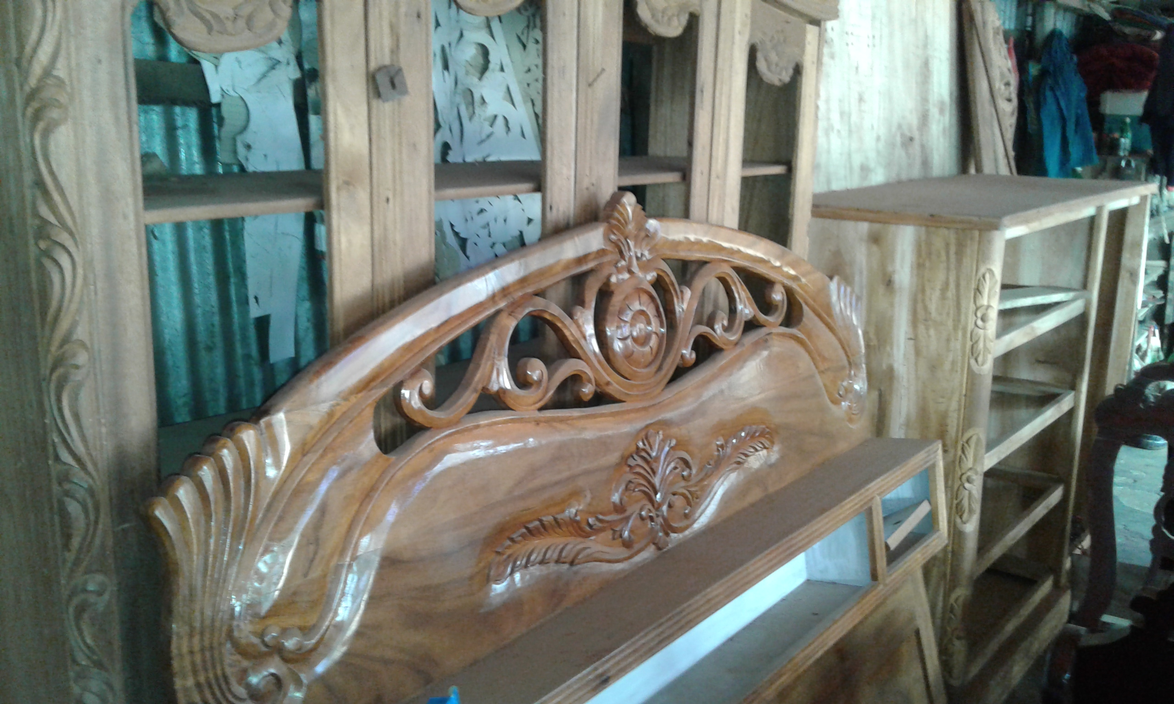

Slide 23
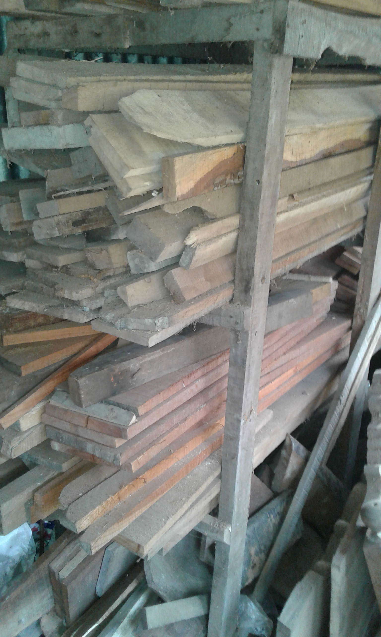

Slide 24
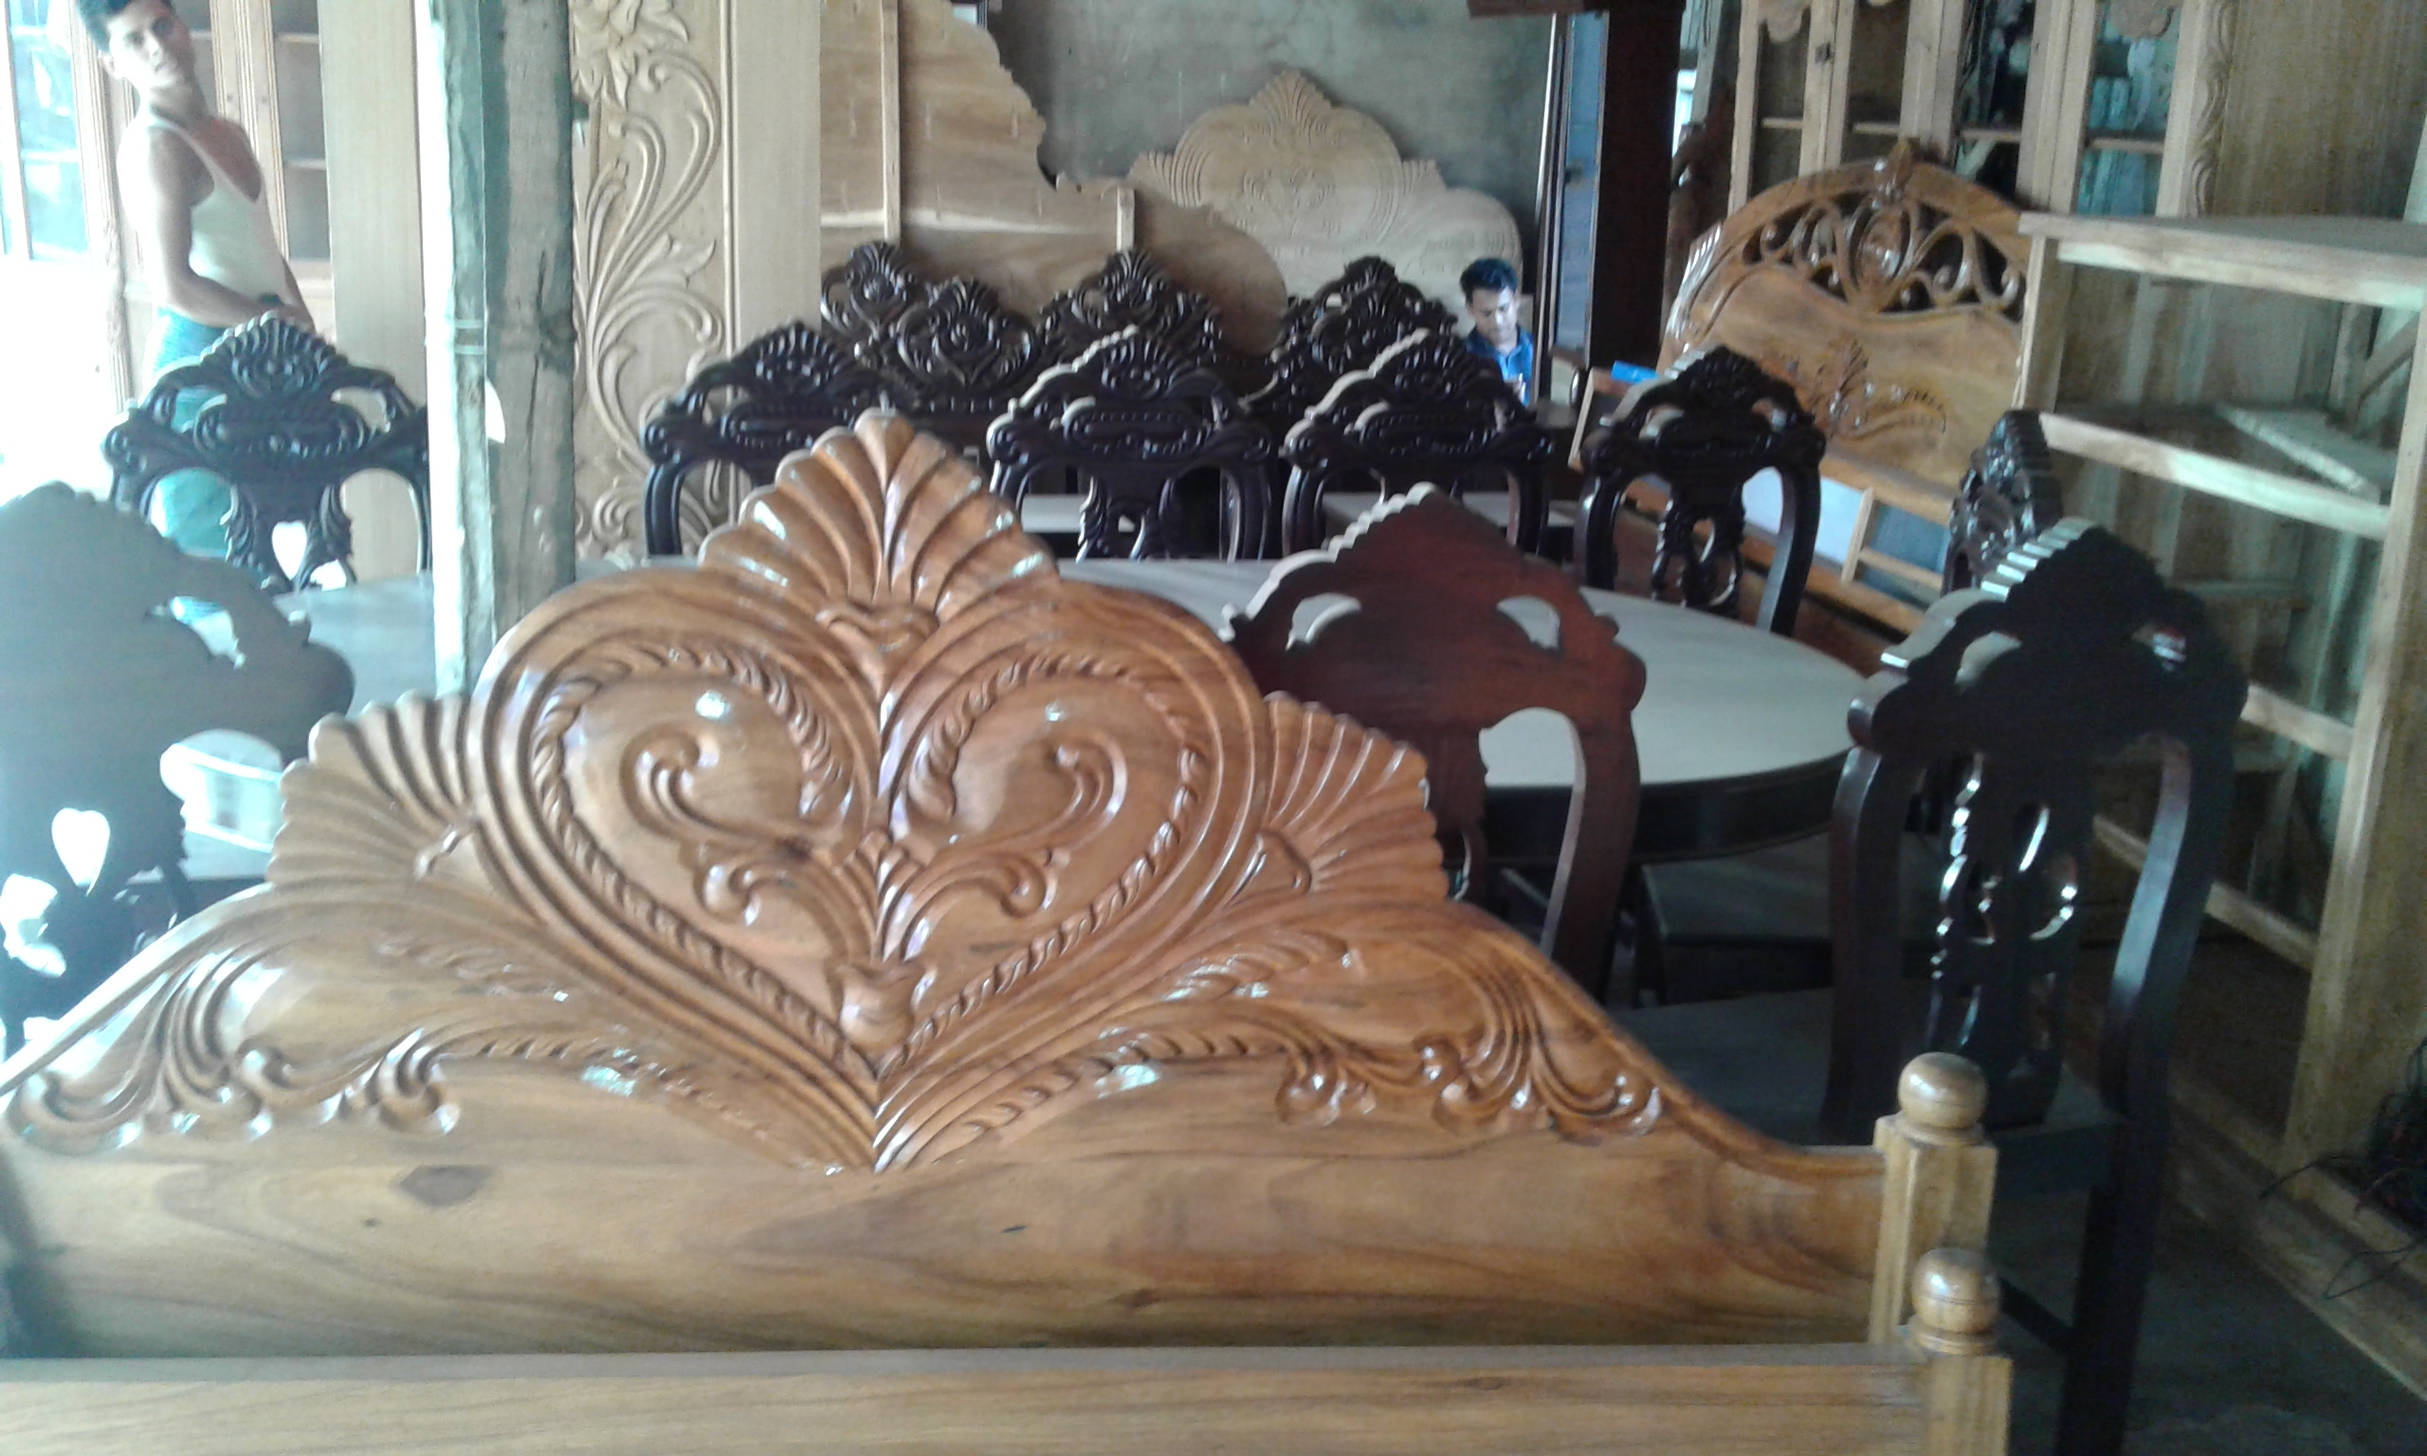

Slide 25
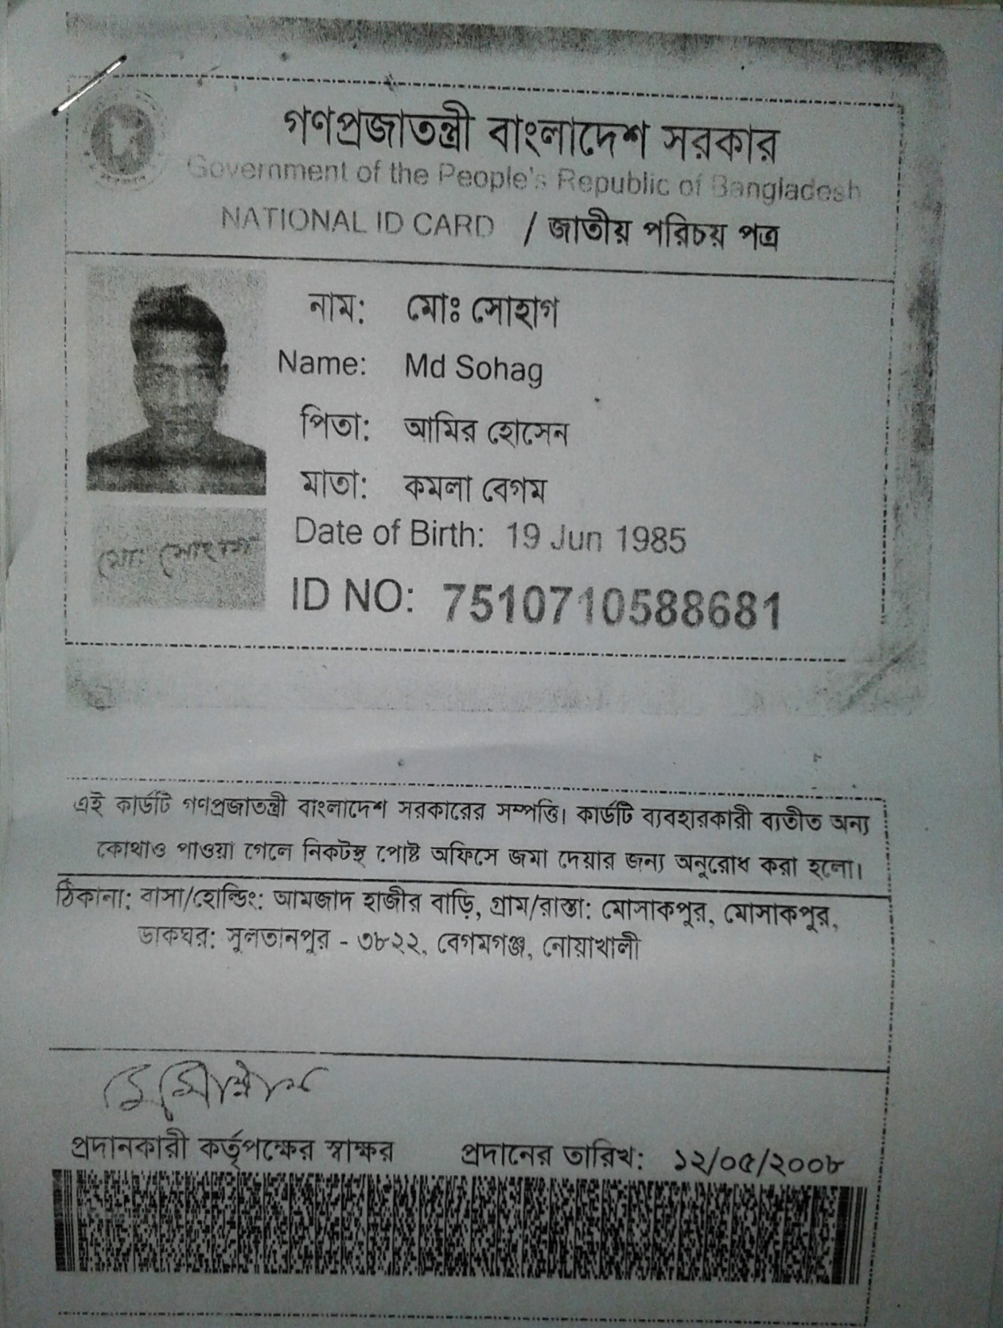

Slide 26
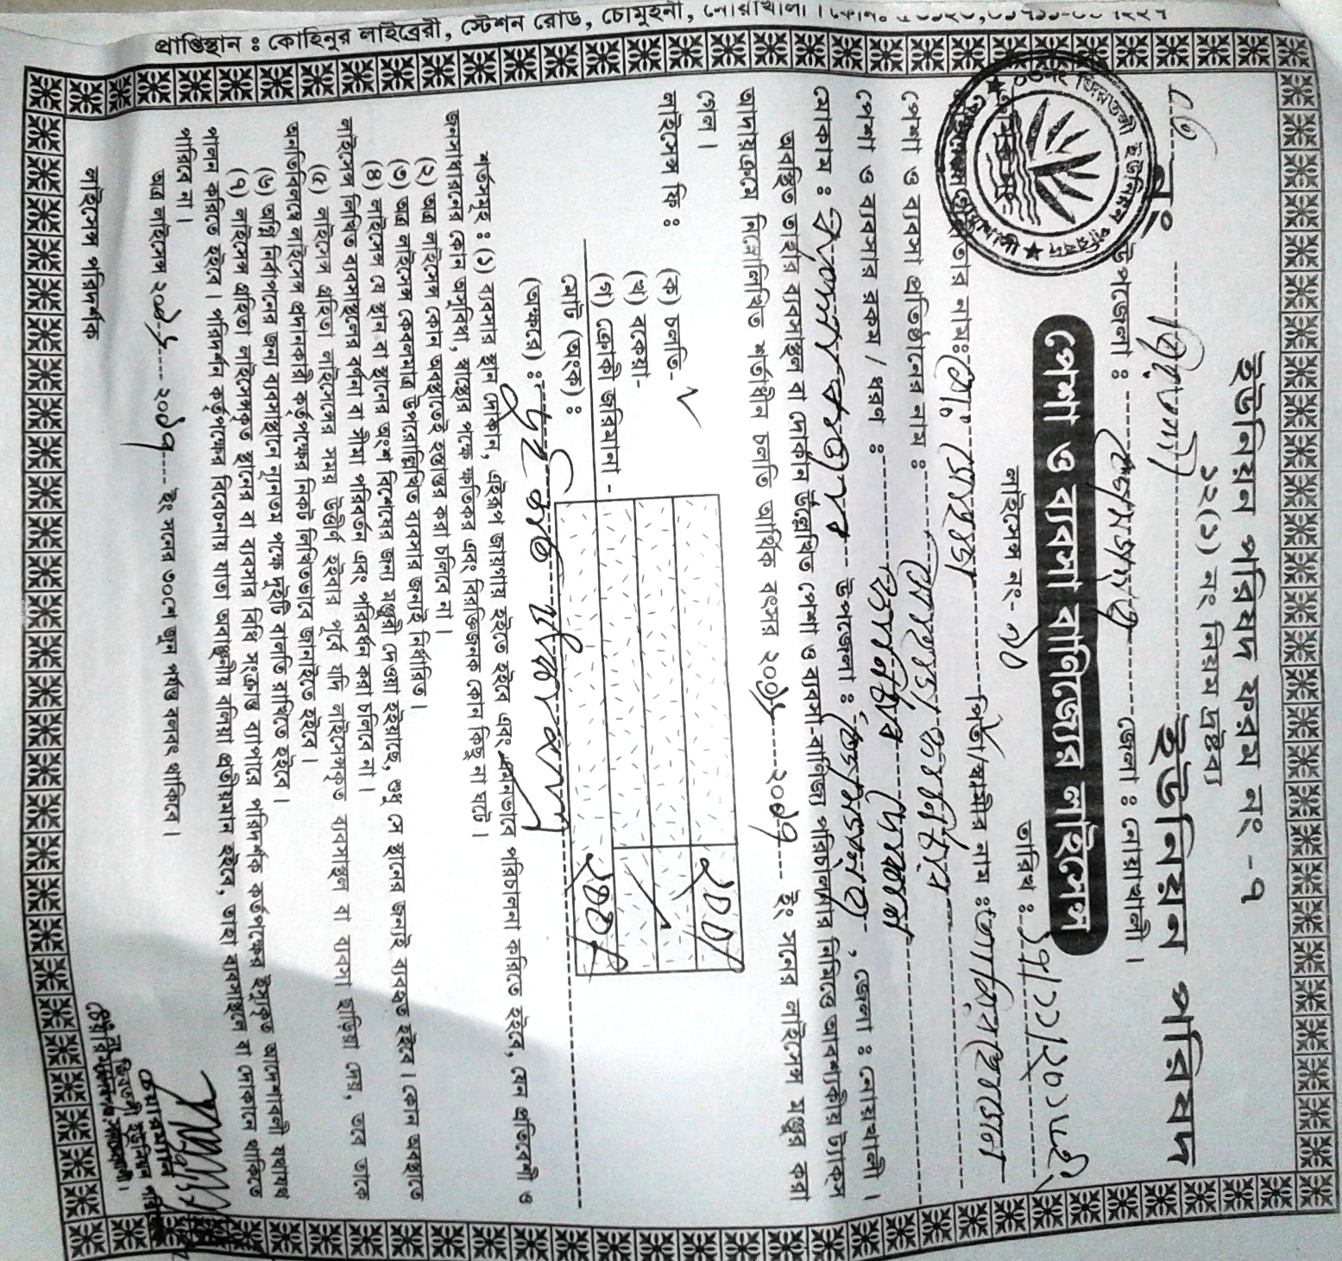

Slide 27
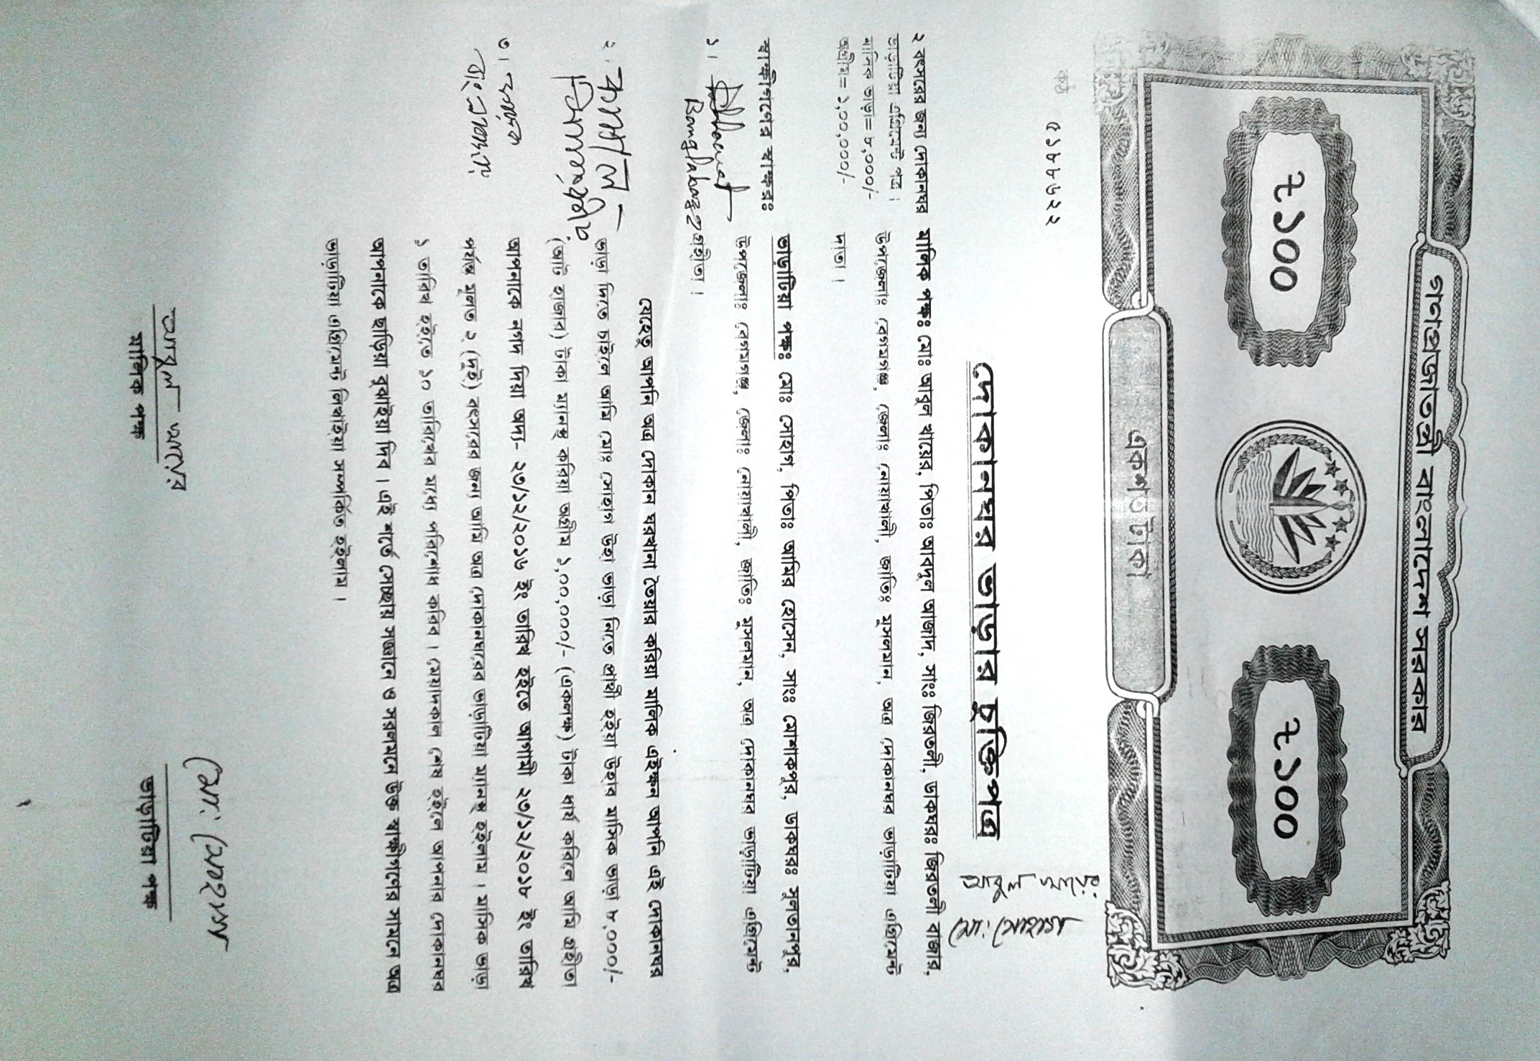

Slide 28
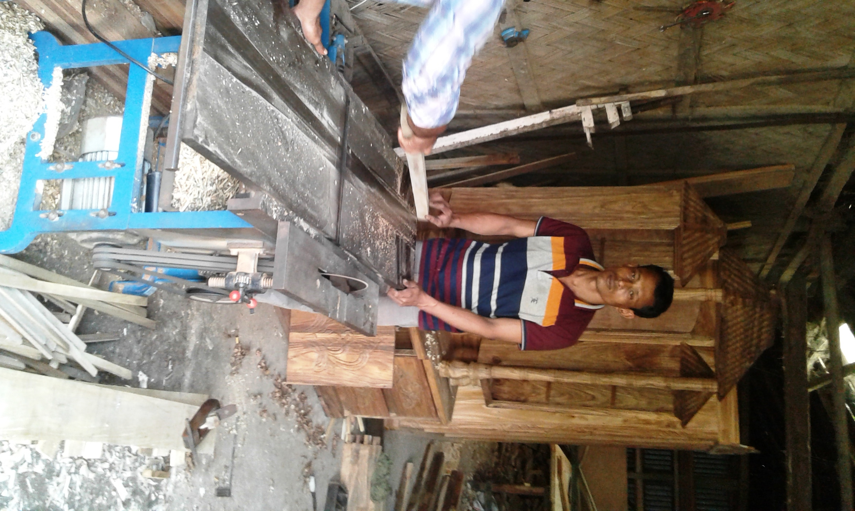

Slide 29
Presented at
SB Design Lab
On January, 2017
For more information
Grameen Trust
Phone No : 9017038
Md. Sohag
Cell No: - +8801795-930019

